Slide 1
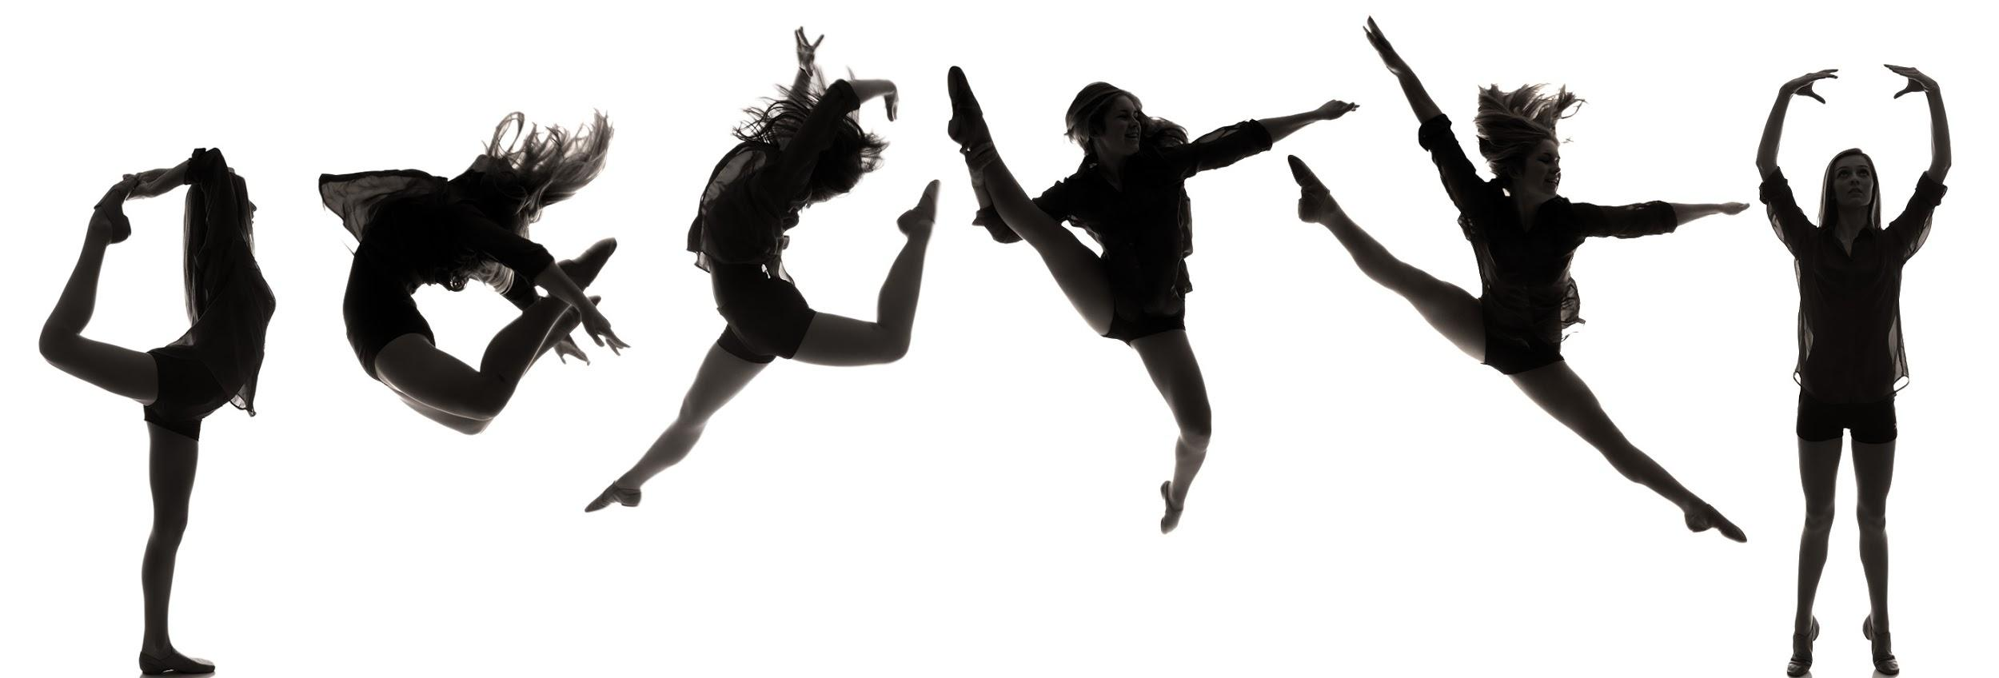
A Glance at DANCE with
Spotlight Dance NOLA
An Introduction and Exploration of Movement
Tots Virtual Lesson 1: Animals

Slide 2
Student Expectations
When we cannot physically meet in the studio, you will more than likely receive virtual packages to work on independently.
Follow the prompts precisely.
Be responsible.
Do your best work.

Slide 3
Dancer Expectations
All black active wear.
Room to move.
100% effort.
Energetic.
Open to learning new things.
Unafraid to make mistakes.

Slide 4
Dancer Etiquette
Distraction-free jewelry. Hanging jewelry is potentially dangerous to you and others.
Listen while the dance teacher is talking. If possible, find a distraction-free area with little noise.
Stow away the cell phone. Turn off—don’t just silence—your cell phone. Putting it on vibrate can still make distracting noise.
Try your best. If you make the mistake of taking a dance class that’s above your skill level, never walk out of a class or sit down in frustration—hang in there and try your best, no one will fault you for that.
Be energetic and practice as if you were in the studio space.

Slide 5
Warm Up
101

Slide 6
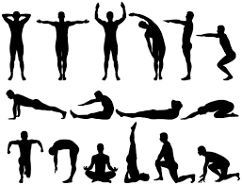
What are the 3 stages of a warm up in dance?
Step 1: Loosening joints. The first step of warming up is to mobilise your joints. ...
Step 2: Stretching muscles. These are dynamic stretches, keeping a constant movement.
Step 3: Pumping your heart.

Slide 7
Watch & Learn
https://www.youtube.com/watch?v=gN3pn_alymA
https://www.youtube.com/watch?v=PKyuJhHQCfI
https://www.youtube.com/watch?v=gN3pn_alymA
Dance Warmups & Stretches for toddlers
Please film your tot and send me their warm up before Thursday’s class.

