Slide 1
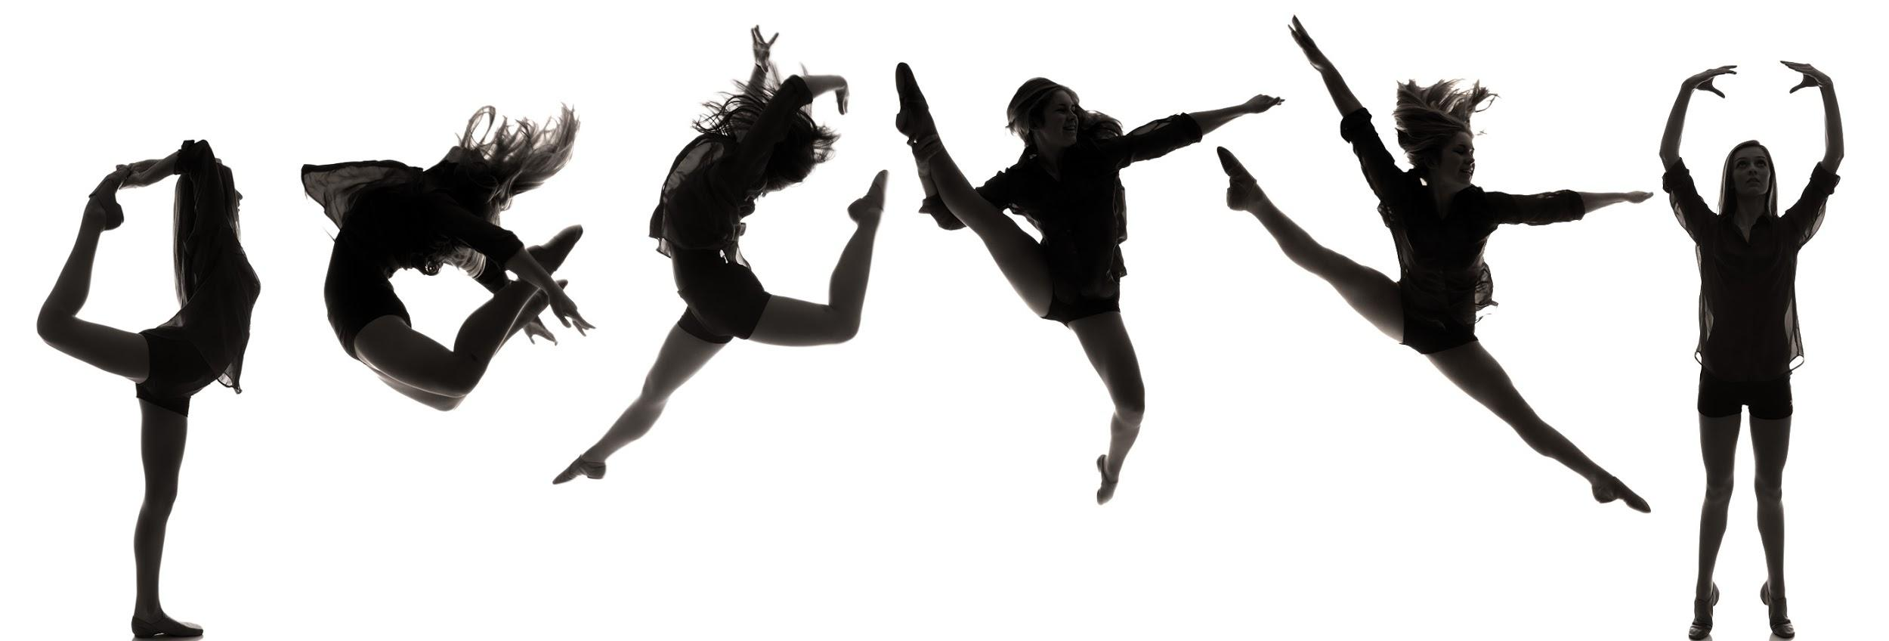
A Glance at DANCE with
Spotlight Dance NOLA
An Introduction and Exploration of Movement
Dance 101

Slide 2
Student Expectations
When we cannot physically meet in the studio, you will more than likely receive virtual packages to work on independently.
Follow the prompts precisely.
Be responsible.
Do your best work.

Slide 3
Dancer Expectations
All black active wear.
Room to move.
100% effort.
Energetic.
Open to learning new things.
Unafraid to make mistakes.

Slide 4
Dancer Etiquette
Distraction-free jewelry. Hanging jewelry is potentially dangerous to you and others.
Listen while the dance teacher is talking. If possible, find a distraction-free area with little noise.
Stow away the cell phone. Turn off—don’t just silence—your cell phone. Putting it on vibrate can still make distracting noise.
Try your best. If you make the mistake of taking a dance class that’s above your skill level, never walk out of a class or sit down in frustration—hang in there and try your best, no one will fault you for that.
Be energetic and practice as if you were in the studio space.

Slide 5
Name Game - Shape Sequence
How do you spell your name?
Pick a movement or shape that represents each letter in your name and create a dance.
Take a minute of think time and in a spotlight dance nola or all black shirt and black leggings, film yourself performing your choreography that spells your name! Email it to Miss Tai before Wednesday taiteamer@gmail.com with the subject “name game_your name”

Slide 6
Do Now
Why do you dance ?
On a word document, answer the question “why you dance”

Slide 7
What is dance ?
On your word document, answer the question “what is dance” in your own words.

Slide 8
Dance
Dance is a performing art form consisting of purposefully selected sequences of human movement. This movement has aesthetic and symbolic value, and is acknowledged as dance by performers and observers within a particular culture.

Slide 9
Match the correct terms with the definitions
On your word document, match the term with the correct definition. For example: 1. “1 E”
things following one after the other
concerned with beauty or the appreciation of beauty
signifies the immaterial value attributed to an object or an idea, communicates its meaning.
person who entertains an audience
person who watches or notices something
manifestations of human intellectual achievement regarded collectively; the customs, arts, social institutions, and achievements of a particular nation, people, or other social group.
Observers
Symbolic Value
Sequence
Aesthetic
Culture
Performers

Slide 10
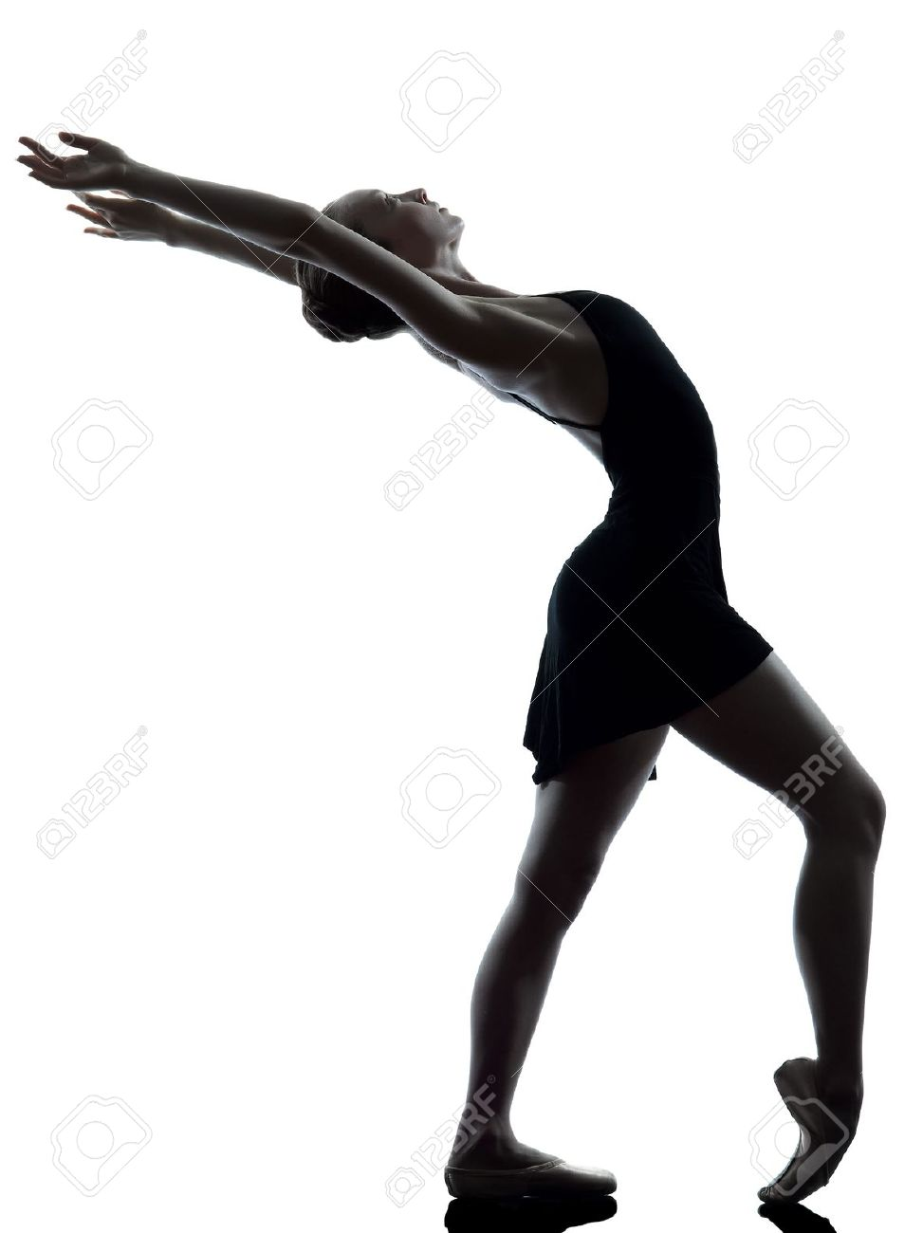
Warm Up
101

Slide 11
Why is warming up for a dance class important?
The Benefits of Dance Warm-ups
Warm Ups are important because they prepare the body for the physical exertion you'll be partaking in later. ... Warm-ups help raise your internal body temperature and will help increase your heart rate and blood flow to the muscles so you can perform better.

Slide 12
What should a dance warm up include?
A warm up should include exercises for ankles, knees, hips, spine, shoulders, elbows and wrists with 6-8 repetitions of each exercise. By the end of the warm up you should feel warm, relaxed and ready to start dancing Professional Performers should conduct a warm which lasts for a minimum of 30-40 minutes each time.

Slide 13
The Best Ways to Warm Up Before Dance Class
Brisk walking.
Jumping jacks or small jumps in place.
Light jogging, marching, prancing, skipping (around the room or in place)
Lunges across the floor or a large Charleston step.
Push Ups.

Slide 14
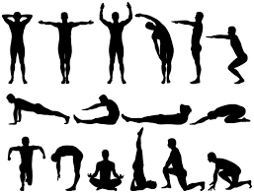
What are the 3 stages of a warm up in dance?
Step 1: Loosening joints. The first step of warming up is to mobilise your joints. ...
Step 2: Stretching muscles. These are dynamic stretches, keeping a constant movement.
Step 3: Pumping your heart.

Slide 15
Watch & Learn
https://www.youtube.com/watch?v=PmIKrzDvJHs
Dance Warmups & Stretches @MissAuti

Slide 16
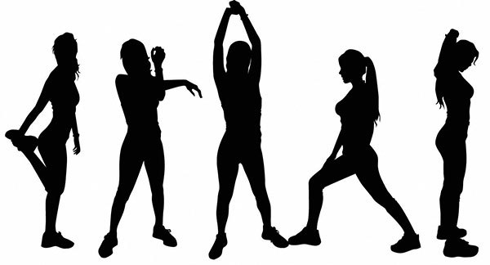
Create your own Warm Up
Create your own warm up and in a Spotlight Dance NOLA or black shirt and black leggings film yourself talking through and executing a 1-2 minute warm up and email it to taiteamer@gmail.com with the subject virtual session 1_your name

Slide 17
All Done!
Please compile your email to taiteamer@gmail.com include both videos and your word document attached with the subject virtual lesson 1_your name
See You In the Spotlight

